Slide 1
Vision Transformer

Slide 2
Agenda
Vision Transformer
CNN / Transfer Learning
Limitation
History/Back Ground / Evolution
Working
Self Attention
Patch Embedding
Class Token
Postional Embedding
Architecture
Demo
Conclusion

Slide 3
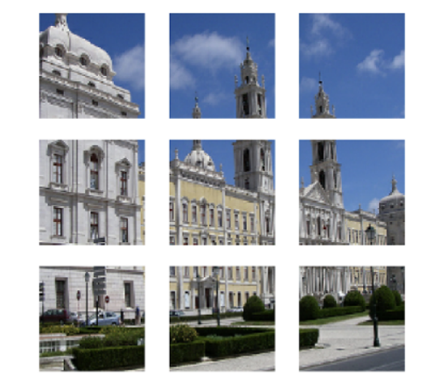

What is Vision Transformer ?
Vision Transformer - is a architecture used to perform image classification task. The architecture is used extensively in NLP and has been de-facto for NLP tasks and CNN/Resnet-like architectures have been the state of the art for Computer Vision but it can be used in computer vision as well. A pure transformer can be applied directly to sequences of image patches which can perform very well on image classification tasks. So complete reliance on CNN is not necessary. In vision, attention is either applied in conjunction with convolutional networks, or used to replace certain components of convolutional networks while keeping their overall structure in place.
Patches of Image
Actual Image

Slide 4
CNN / Transfer Learning - Limitation
CNN do not encode the position and orientation of object
A Convolutional neural network is significantly slower due to an operation such as maxpool.
Transfer learning only works if the initial and target problems are similar enough for the first round of training to be relevant.

Slide 5
History of ViT
A vision transformer (ViT) is a transformer that is targeted at vision processing tasks such as image recognition . A paper named “An Image is Worth 16x16 Words: Transformers for Image Recognition at Scale” was published by Alexey Dosovitskiy along with others in the year 2020. It created a revolution in the field of computer vision.

Slide 6
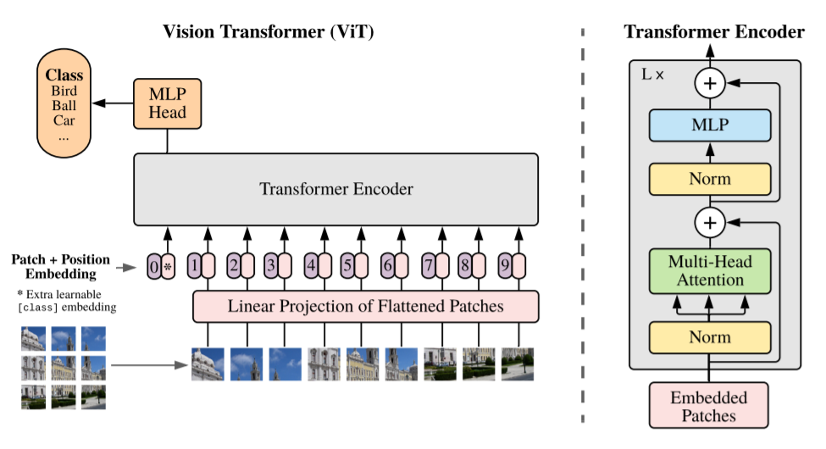
Architecture

Slide 7
Vision Transformer Pseudo-Code
This is the pseudo code for the sequence of operations on a image to classify it using the Vision Transformer Model.
def ViT (input):
patches = Create_Patches(input)
patch_embed = Patch_Embedding(patches)
sequence = Concat(class_token, patch_embed) + Position_embedding
hidden_states = Transformer(sequence)
class_output = Classification_Head(hidden_states[0])
return class_output

Slide 8
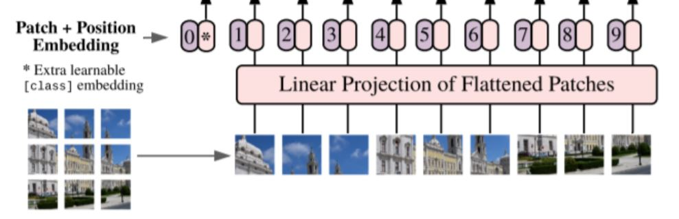
Terminology
Patch Embedding – Transformer receives 1D embedding as input. To handle 2D image input, the image is divided into sequence of flattened 2D fixed size image patches. An image is represented as
3D Image (X) ∈ resolution R (H*W*C)
reshape the 3D image into flattened 2D patches
Patch Image ( Xp) ∈ R N*(P^2*C)
Where sequence length N = H . W / P2 and (P, P) is the resolution of each image patch.
Each patch is a D dimension vector with a trainable linear projection.

Slide 9
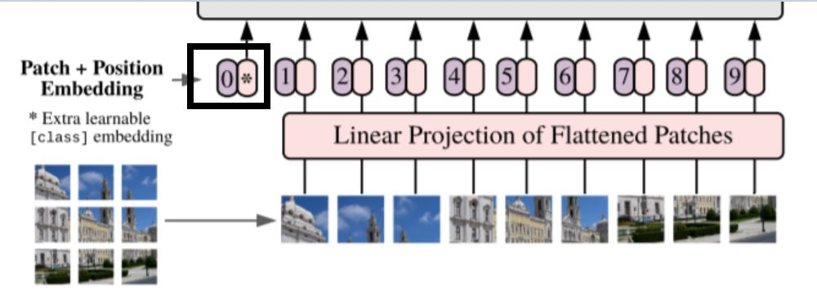
Terminology
Class Token - As seen in implementation of BERT’s [class] token, a learnable embedding is prepended to the sequence of embedded patches (z₀⁰ = x_{class} ).
z⁰ = [x_{class}; x¹_{p}E; x²_{p}E; · · · ; x^{N}_{p} E] + E_{pos}, E ∈ R^{(P^2C)×D}, E_{pos} ∈ R^{(N+1)×D}
X_{class} is a class label and X^{N}_{p} is patch images N ∈ 1 to n
Using the transformer encoder to pre-train we always need a Class label at the 0th position. When we pass the patch images as inputs we always need to prepend one classification token as the first patch as shown in the figure.

Slide 10
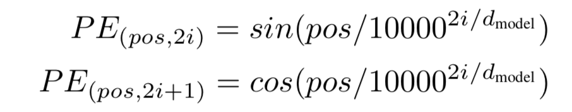
Terminlogy
Positional Embedding - Since Transformers need to learn the inductive biases for the task they are being trained for, it is always beneficial to help that learning process by all means. Any inductive bias that we can include in the inputs of the model will facilitate its learning and improve the results.
Position embeddings are added to the patch embeddings to retain positional information. In Computer Vision, these embeddings can represent either the position of a feature in a 1-dimensional flattened sequence or they can represent a 2-dimensional position of a feature.
1-dimensional: a sequence of patches, works better
2-dimensional: X-embedding and Y-embedding

Slide 11
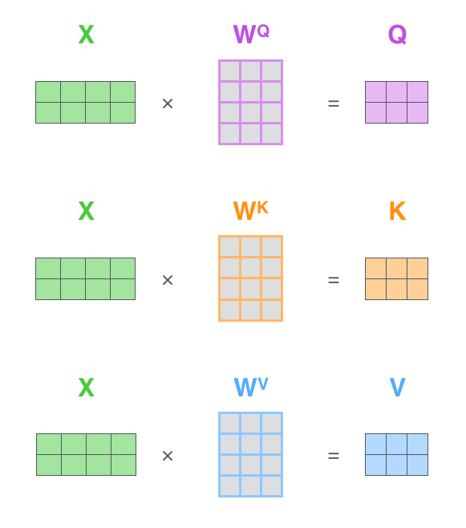
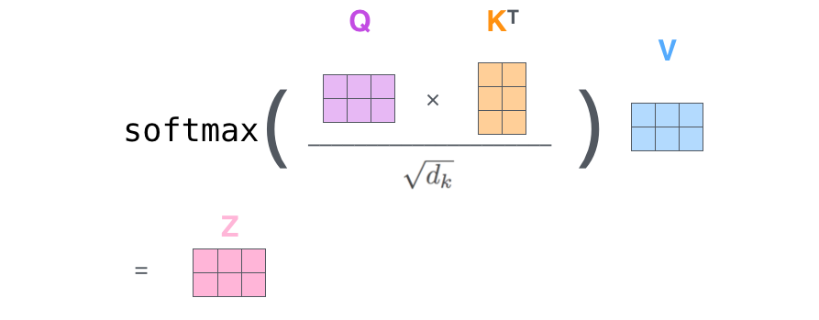
Self Attention
Self Attention - As seen in NLP, how one word pays attention to other words to find the relation between the words. Similarly to the image, the model transformer passes one pixel to attend to every other pixel.
Matrix Calculation -
Input Image
Query
Query
Key
Value
Key
(Output of Self-Attention Head 1 )
Value

Slide 12
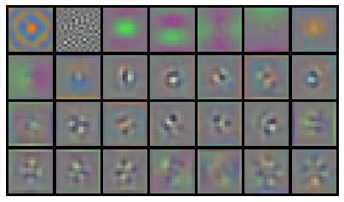
Working of Vision Transformer
Below steps are followed in implementation -
Step 1 - Split an image into patches. Image patches are treated as words in NLP. We have patch embedding layers that are input to transformer blocks. The sequence of pictures will have its own vectors. List of vectors as a picture because a picture is 16 times 16 words region transformer.
Step 2 - The input sequence consists of a flattened vector ( 2D to 1D ) of pixel values from a patch of size 16×16. Each flattened element is fed into a linear projection layer that will produce what they call the “Patch embedding”.
First 28 principal components of the initial RGB linear Embedding Filter for pre-trained model ViT - B/16

Slide 13
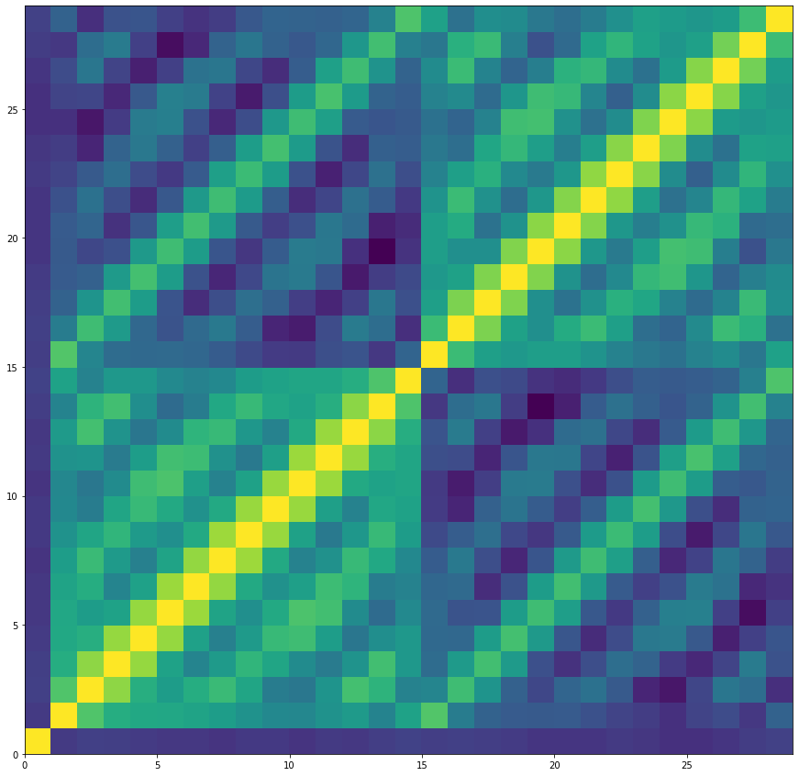
Working of Vision Transformer
Step 3 - Position embedding are then linearly added to the sequence of image patches so that the images can retain their positional information. It injects information about the relative or absolute position of the image patches in the sequence.
Position Embedding
The Cosine Similarity Matrix of learnable Position Embeddings denotes clear locality pattern as every 14th value is highly correlated as the patch size (16) divides the image(224x224) into a 14x14 matrix. The very first position embedding is orthogonal to all others since it is reserved for the class token.

Slide 14
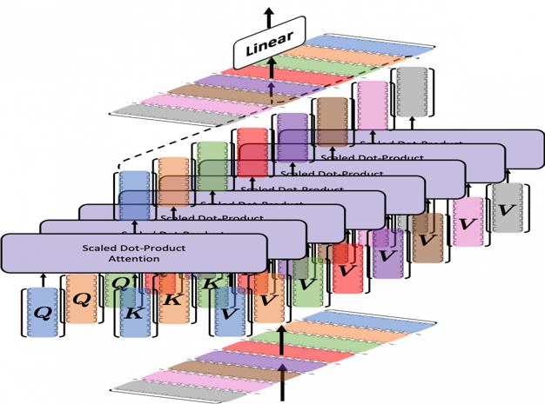
Working of Vision Transformer
Step 4 - An extra learnable ( class) embedding is attached to the sequence according to the position of the image patch. This class embedding is used to predict the class of the input image after being updated by self-attention
Step 5 – The Transformer encoder module comprises a Multi-Head Self Attention ( MSA ) layer and a Multi-Layer Perceptron (MLP) layer. The Multi-Head Self Attention layer split inputs into several heads so that each head can learn different levels of self-attention. The outputs of all the heads are then concatenated and passed through the Multi-Layer Perceptron.

Slide 15
Working of Vision Transformer
Step 6 – Layernorm (LN) is applied before every block, and residual connections after every block. The MLP contains two layers with a GELU non-linearity. Finally, an extra learnable classification module (the MLP Head) is added to the transformer encoder, giving the network’s output classes.
Step 7 - The classification is performed by just stacking an MLP Head on top of the Transformer, at the position of the extra learnable embedding that we added to the sequence.

Slide 16

RESULTS

Slide 17
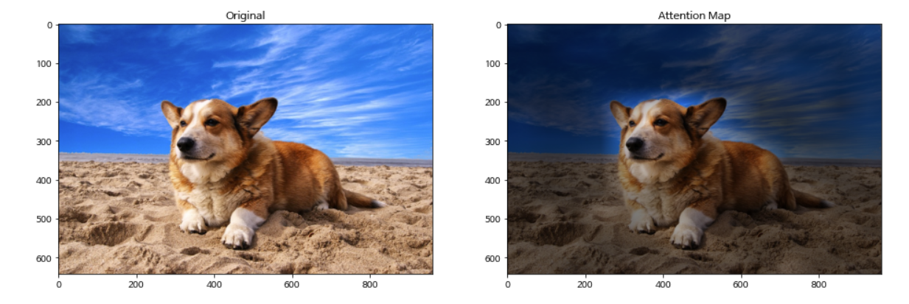
Attention Pattern Analysis
Attention pattern analysis -
A representative example of attention from the output token to the input space. Average attention weights of all heads mean heads across layers and the head in the same layer. So, basically, the area has every attention in the transformer, this is called attention pattern or attention matrix.
When the patch image is passed through the transformer, the transformer will generate the attention weights matrix for the image patches. When patch-1 is passed through the transformer, self-attention will calculate how much attention should pay to others ( Patch 2, Patch 3,….). And every head will have one attention pattern like shown in the image and finally, they will sum up all attention patterns ( all heads )to get the above picture.

Slide 18
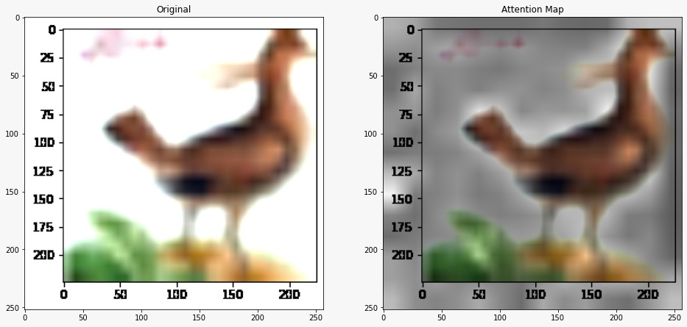
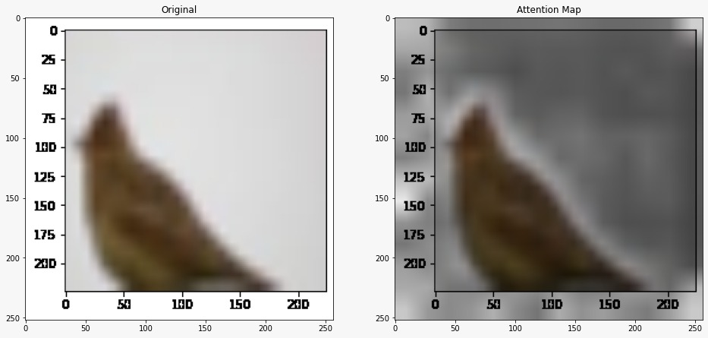
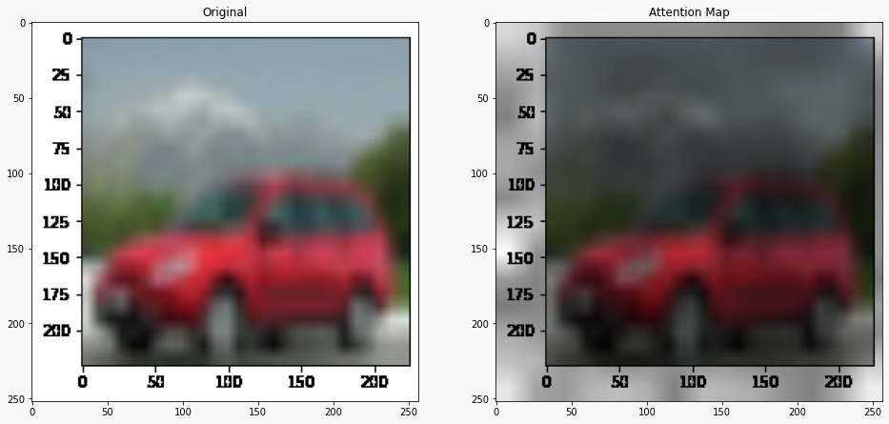
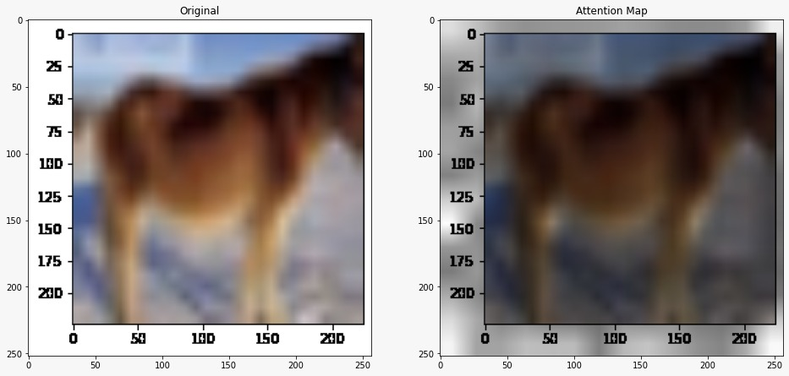
Attention Map Visualisation
Representative examples of attention from the output token to the input space

Slide 19
Conclusion:
Transformers solve a problem that was not only limited to NLP, but also to Computer Vision tasks.
Huge models (ViT-H) generally do better than large models (ViT-L) and wins against state-of-the-art methods.
CNN’s uses filters on a patch of an image to extract important features and edges. This helps the model to learn only the necessary important features from an image, and not details of each pixel of an image.
Vision transformers work better on large-scale data.
Attention Rollouts are used to compute the attention maps.
Convolutions are translation invariant, locality-sensitive, and lack a global understanding of images
If entire image data is fed into a model, rather than just the parts that the filters can extract (or it considers important), the chances of the model performance will be higher. This is exactly happening inside a Visual Transformer. This can be one reason Vision Transformers work better than most CNN models.
CNN still very much effective for tasks like object detection and image classification. As ViT works better on large-scale data, so we can use of ResNet and other models which are state-of-the-art convolutional architectures for all types (small, medium, and large )datasets.

Slide 20
Conclusion:
Vision transformer is pretrained on large datasets like Imagenet-1k, Imagenet-21k, JFT-300M. And based on task, it’s fine tuned on the task dataset.
Like the GPT-3 and BERT models, the Visual Transformer model also can scale.
Large-scale training outperforms inductive bias.

Slide 21
Demo:

Slide 22
References
https://en.wikipedia.org/wiki/Vision_transformer
https://keras.io/examples/vision/image_classification_with_vision_transformer/
https://arxiv.org/abs/2010.11929
https://www.analyticsvidhya.com/blog/2021/03/an-image-is-worth-16x16-words-transformers-for-image-recognition-at-scale-vision-transformers

